Slide 1
Object Oriented Programming Lecture-16
Override private methods, Parent and Child classes having same data member
Prof. Varsha Dange

Slide 2
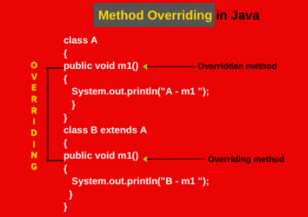
Method overriding in Java
Method overriding in Java means redefining a method in a subclass to replace the functionality of superclass method.
If subclass (child class) has the same method as declared in the parent class, it is known as method overriding in Java.
To override a method in a subclass, the method must be defined in the subclass using the same signature and same return type as in its superclass as shown in the below figure.

Slide 3
Method overriding in Java
The superclass method which is to be override is called overridden method.
The subclass method which is overriding the superclass method is called overriding method in java.
Usage of Java Method Overriding
Method overriding is used to provide the specific implementation of a method which is already provided by its superclass.
Method overriding is used for runtime polymorphism

Slide 4
Method Overriding rules in Java
The method must have the same name as in the parent class
The method must have the same parameter as in the parent class.
In other words, the method signature must be the same or matched.
There must be an IS-A relationship (inheritance).
Subclass method’s return type must be the same as superclass method return type.
But this rule is applicable until Java 1.4 version only.
From Java 1.5 version onwards, covariant return types are also allowed.
Only the instance method can be overridden in Java.
An instance variable can never be overridden in Java.
Overriding concept is not applicable for private, final, static, and main method in Java.

Slide 5
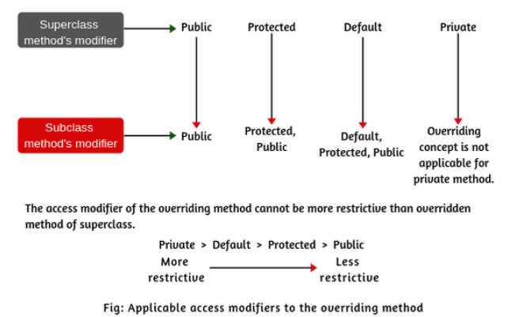
Method Overriding rules in Java

Slide 6
Method Overriding rules in Java
1. While the overriding method, we can increase the visibility of the overriding method but cannot reduce it.
For example, if superclass method is protected, we can override as a public method in the subclass.
2. Similarly, the default method of superclass can be overridden by default, protected, or public.
3. We cannot override a method if we do not inherit it.
A private method cannot be overridden because it cannot be inherited in the subclass.

Slide 7
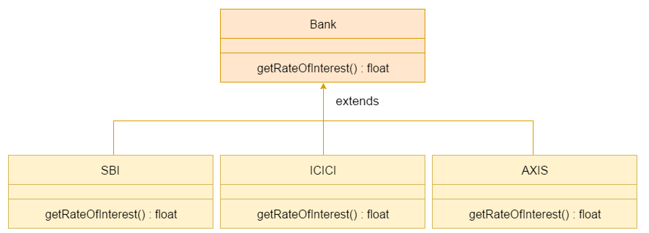
Method Overriding rules in Java
Example1
Example2

Slide 8
Who (Java compiler or JVM) decide which method is to be executed?
In method overriding, JVM decides method call depending on the runtime object of the class.
method resolution is always resolved by JVM based on the runtime object.
During runtime, the actual object is used for calling the method.

Slide 9
Role of Java Compiler & JVM in Overriding
Role of JVM in overriding: : Example
At runtime, JVM will check that the reference variable is pointing to the which class object? parent class object or child class object.
If it is pointing to the parent class object and m2() method is available in the parent class, it will execute the m2() method of the parent class.
But if it is pointing to the child class object, JVM will immediately check that in the child class, the m2 method is overriding or not.
If it is not overriding in the child class, JVM will call the default parent m2 method available in the child class.
Thus, JVM will execute the parent method only.
If the m2 is overriding in the child class, at the runtime, JVM will execute the child class method based on the runtime object (new B()).
In the overriding method, the resolution is always based on the runtime object by JVM.
Example

Slide 10
Why Method overriding is called Runtime polymorphism?
Let’s consider program : Example
A a1 = new B();
a1.m2();
The above line is compiled as class A has m2().
At runtime, we will get the output of m1 which is there at class B.
As at compile time, we think m2 of class A will get called but at runtime m2 of class B got executed
because, in method overriding, method resolution is always based on runtime object (new B()).
Therefore, it is also called runtime polymorphism or dynamic polymorphism, or late binding in java.

Slide 11
Why cannot private method be overridden?
We cannot override private method because when superclass method is private, it will not be visible to the subclass.
Whatever methods we writing in the subclass will be treated as a new method but not an overridden method.
Example

Slide 12
Can we override static method in Java?
No, we cannot override static method in java because a static method is resolved at compile time by java compiler whereas,
Method overriding is resolved at runtime by JVM because objects are only available at runtime.
We can declare static methods with the same signature in subclass, but they are not considered as overriding. They are considered a method hiding.
Example : (eg-not a valid case)
Example : (eg-not a valid case)
Example : (eg-valid case)

Slide 13
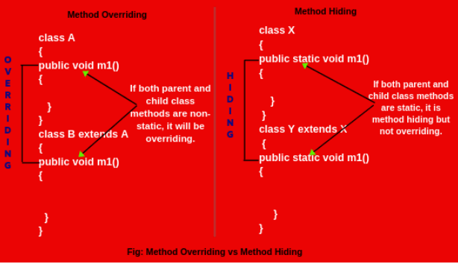
Can we override static method in Java?

Slide 14
Can we stop method overriding in Java?
Yes, we can stop method overriding by declaring method as final.
Example
Use of Method overriding in Java
1. . Method overriding is used to achieve runtime polymorphism in Java. 2. It is used to change the existing functionality of the superclass method.
Note: Method overriding occurs only when the signatures of the super and subclasses methods are identical. If they are not, then both methods are simply overloaded methods

Slide 15
Covariant Return Types in Java with Example
As we know that in the overriding, the return type of subclass method must be the same as the superclass method return type.
But this rule is applicable until Java 1.4 version.
From Java 1.5 onwards, a new covariant return types feature was introduced by Sun Microsystem.
By using this feature, it is possible to override any method by changing the return type only.

Slide 16
Rules for Covariant Return Type in Java
1. The return type of overriding method in the subclass should be either the same as the return type of superclass or subclass.
2. The return type of overriding method in the subclass should not be a parent of the parent method return type.
3. The covariant return type is applicable only for Object types not for primitive types.

Slide 17
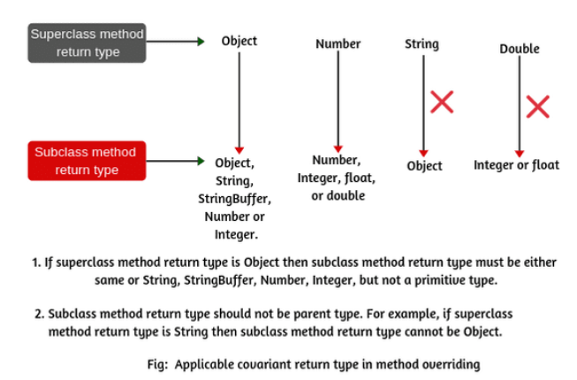
Rules for Covariant Return Type in Java

Slide 18
Rules for Covariant Return Type in Java
Example
Example1
Example2
Example3
Key Points:
1. Java SE5 adds a new feature Covariant return type which means
we can override any method by changing return type if the return type of subclass overriding method is subclass type.
2. Covariant return type also helps to minimize upcasting and downcasting in Java.

Slide 19
Parent and Child classes having same data member in Java
it is possible to have same data member in Parent and Child classes.
The Parent class reference can hold its own object and Child class object as well and The Child class reference hold its own object only.
The Parent class object can access their data only that's means this class doesn't have permission to access Child class data.
Example1
example2

Slide 20


Parent and Child classes having same data member in Java
in the above program we have four cases:
1. If Base class reference holds an object of Base class then it is perfectly valid and we can access only Base class data member.
2. If Derived class reference holds an object of Derived class then it is perfectly valid and we can access both Base and Derived class data member.

Slide 21



Parent and Child classes having same data member in Java
in the above program we have four cases:
3. If Base class reference holds an object of Derived class then it is also perfectly valid but it can access only Base class data member.
If Derived class reference holds an object of Base class then it is perfectly invalid and in that case we will get compile time error.

